Slide 1
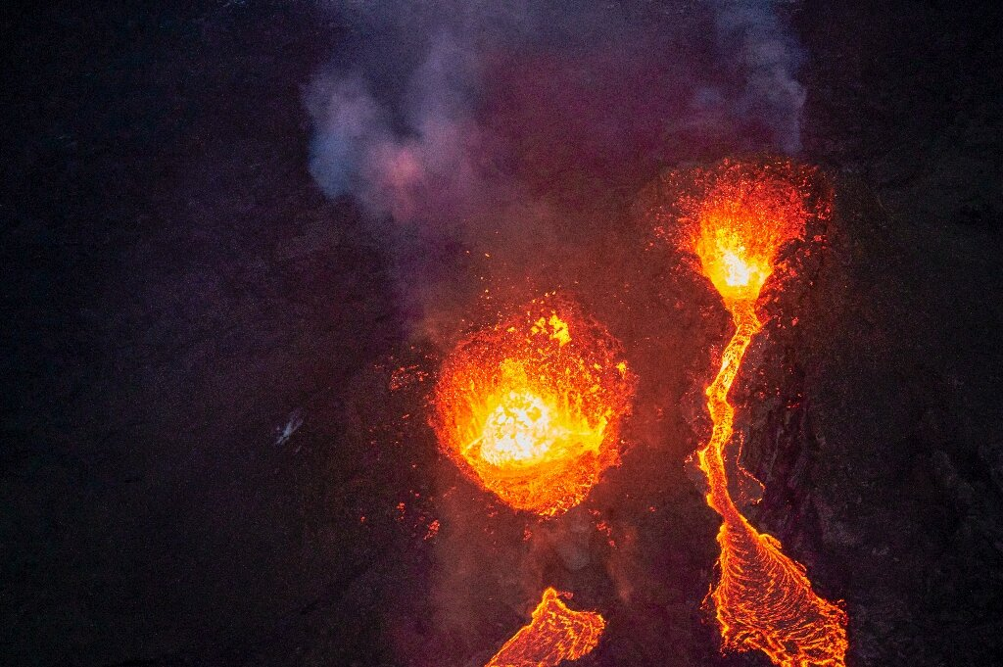
Volcanoes
By: Loz and Olivia
Notes:
Olivia

Slide 2
Volcanoes Impact Spheres
Volcanoes are apart of the geosphere
They release amounts of particles into the atmosphere
Water can become warmer and more acidic
They destroy habitats
Notes:
Loz - Volcanoes Impact The Spheres. Volcanoes are apart of the geosphere they release particles like ash into the atmosphere. They also make water warmer and more acidic, the way that it makes water warmer and more acidic is that _____. Volcanoes can also damage the biosphere by destroying habitats.

Slide 3
Cause and Effect Relationships
Areas get flooded
Agricultural land gets damaged
Things are hit by heavy ash fall
Animals are poisoned
Roads are destroyed
Glaciers are destroyed
Notes:
Olivia - Cause and Effect Relationships. Volcanoes have many cause and effect relationships, areas get flooded, Land gets damaged, Things are hit by ash fall causing an unhealthy environment leading to animals getting poisoned, and from magma and the heat of the volcano, roads and glaciers are destroyed.

Slide 4
Geosphere Impacts the Hydrosphere
Changes the weather
Promotes erosion to many new levels
Creates acid rain
Melts glaciers
Things are destroyed
Kills the environment
Notes:
Loz - Geosphere Impacts the Hydrosphere. Volcanoes change the weather and make it so water freezes over or gets warmer. It also promotes erosion, creates acid rain, and melts glaciers. It melts glaciers by releasing heat into the atmosphere and making it warmer. Volcanoes destroy things like they kill the environment by hurting animals and plants.

Slide 5
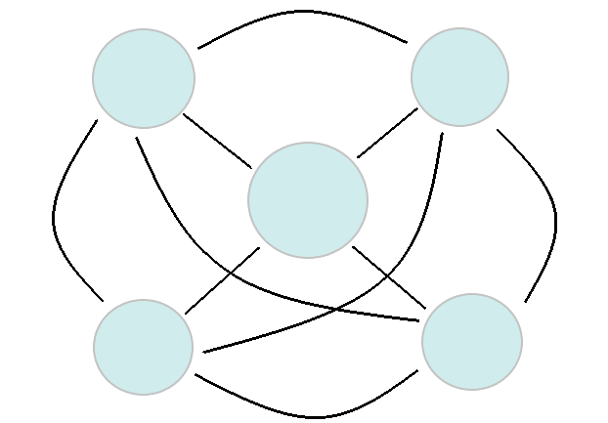
Spheres Diagram
Hydrosphere
Atmosphere
Volcanoes
Geosphere
Biosphere
Notes:
Olivia - Spheres Diagram. This is a diagram of how the spheres interact with volcanoes. They are all connected in a way. _______.

Slide 6
Works Cited
https://phys.org/news/2021-05-earth-power-iceland-volcano-lava.html
Earth Systems Textbook
http://www.csun.edu/science/books/sourcebook/chapters/8-organizing/files/earth-systems-interactions.html
https://www.bbc.co.uk/bitesize/guides/zvnbkqt/revision/4
Paint3D
https://prezi.com/ayhcj7o-10_w/how-volcanoes-affect-the-earths-spheres/#:~:text=Volcanoes%20can%20cause%20many%20changes,glaciers%20and%20icecaps%20to%20melt.
https://lisbdnet.com/which-spheres-are-interacting-when-a-volcano-erupts-and-releases-gases-into-the-air/
Notes:
Loz - Work Cited. Here is what we used for our sites. I hope you enjoyed our presentation on earth spheres in a volcano.
Loz and Olivia - Thank you

